Slide 1
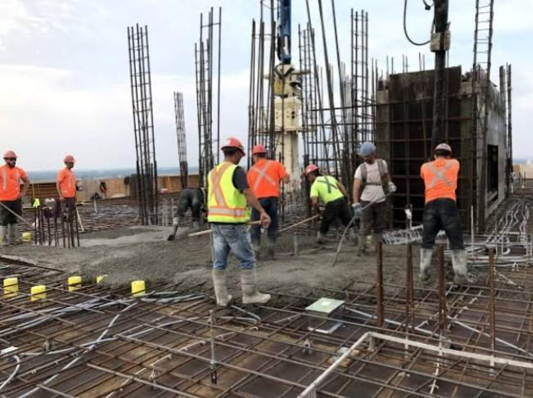
“NO POVERTY” AND “INDUSTRY, INNOVATION”
Idea – Providing Employment for labour’s

Slide 2
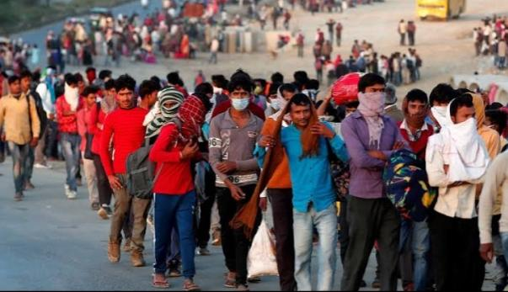
INTRODUCTION:
Poverty and Illiteracy are the two key factors for hindrance in development of India. Illiteracy leads to instability of Job’s.
Covid-19 is a globe-spanning health and socio-economic crisis’. It’s impact can be seen directly at the local level, where it amplifies the pre-existing socio-economic condition in our cities.
In this pandemic, daily wage workers have high risk of Losing their jobs and this will drastically increase the Poverty percentage in up coming days.
This was the main reason and inspiration to create this app.

Slide 3
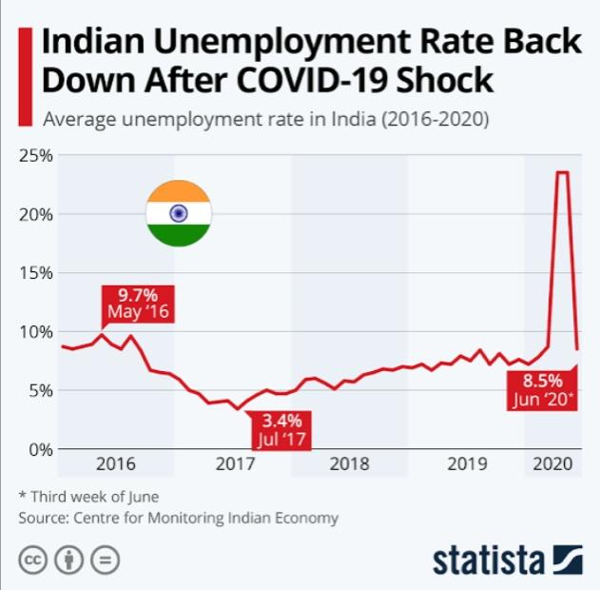
Unemployment Rate:

Slide 4
Idea of the project:
~*~This app provides employment to the workers in construction sites , it works out on daily wage workers to contract
based system. The system provides:
1) Contact work wages:-
• This provides the worker a fixed income, based on the no.of days worked.
2) Convenient work schedule:-
• This ensures that the workers work for a fixed period in a day as per his/her convenience
3) Easy job rotation:-
• After the completion of the given job the worker can move to an another job without any time
delay and restrictions.
4) Point system:-
. • As a form of gratitude the workers who have used the app over a period will be entered into the reward
system, which allows them to earn points and receive bonuses at the end.

Slide 5
Team:
MIHIR
LALITHA
VYSHNAVI
KARISHMA
CSE, SRM AMARAVATI

Slide 6

Thank you
THANK YOU

